Slide 1
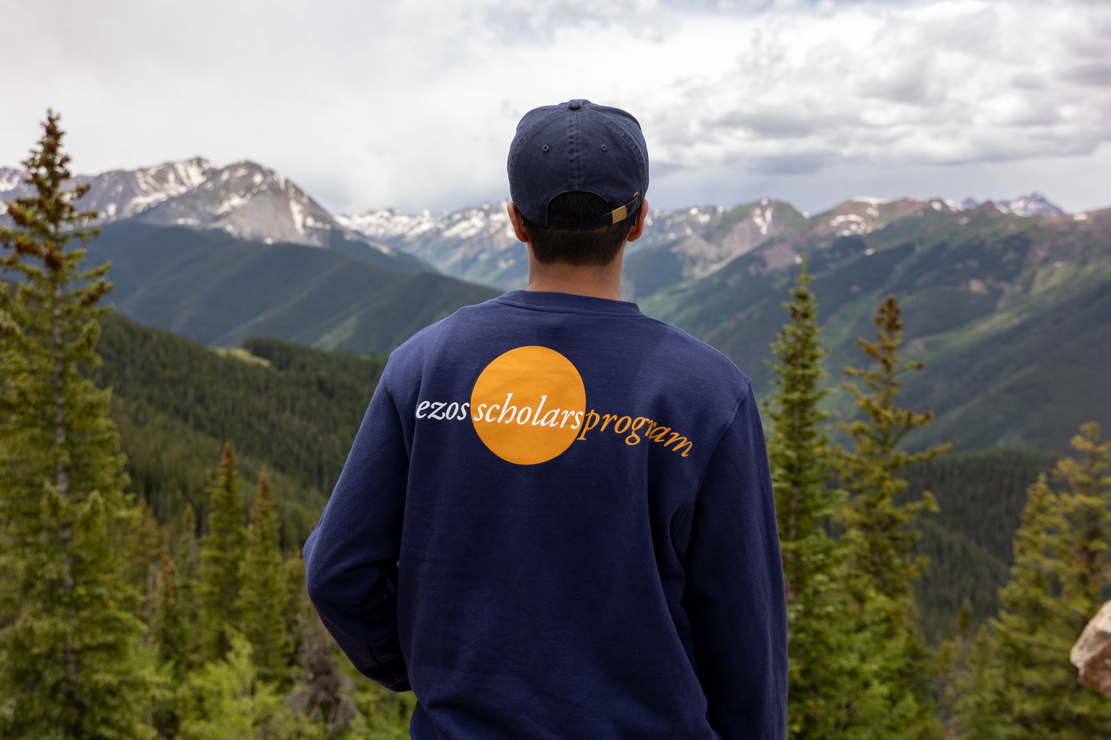

Become the LEADER we NEED
Notes:
Hello!! This slide deck was designed so that whoever is using it can “choose their own adventure”. There is probably more than you need so please review each slide and use what is helpful to cater to the audience you want to use it with. If anything is missing or unclear – please contact us at scholars@bezosfamilyfoundation.org. Many commonly asked questions are covered in the Frequently Asked Questions section of the website: https://www.bezosscholars.org/faq/. Thank you so much for your help in promoting this opportunity!
Potential talking points:
Join me for a short, five-minute presentation about an incredible leadership opportunity open to students that are juniors and a staff person from their school that they nominate as their educator to participate along side them.
This presentation will cover what the program is, why someone should apply and what they will get out of participating, who is eligible, how to apply, and what the application entails.

Slide 2
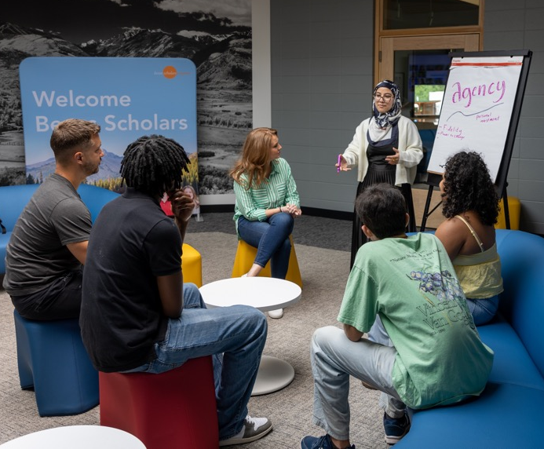
Unlocking the Power of
Youth Leadership
The Bezos Scholars Program is a transformative, year-long, no-cost leadership development program.
Student Scholars engage in leadership development skill-building through project-based learning and receive free college advising.
At the center of the program are Community Change Projects—fresh and sustainable approaches to meeting community needs.
12 Scholars are chosen from public schools across the U.S. and 5 from the African Leadership Academy in South Africa, along with an educator from each school.
Are You a Leader in Your Community?
Notes:
Potential talking points:
Program goal is to amplify youth voice and action.
Participating in the program does not cost anything for the student or educator - all costs associated with the program, and the trip, are covered.
Community Change projects have been developed by students that focus on relevant, tangible needs in their communities such as:
Mental health
Environmental justice
Food insecurity
Diversity, equity, and inclusion
Literacy
Access to STEM opportunities
Anything else you could dream up that is important to young people and impacting the people, places, animals, and things they care about.

Slide 3
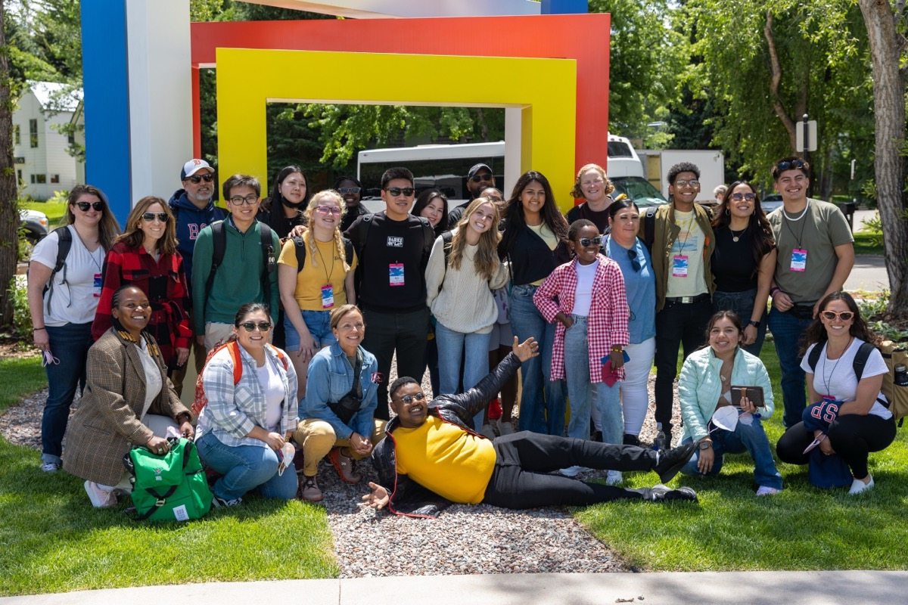
Why Apply?
Form lasting friendships across the U.S. and Africa.
Experience an all-expenses-paid trip to Aspen, Colorado.
Engage in virtual leadership skill-building sessions.
Access supportive coaching from peers and staff.
Receive FREE personalized college advising for an entire year.
Earn $1,000 to launch a Community Change Project.
“BSP opened up the world for me and gave me a sense of perspective. The broader awareness and long-term vision I formed is a foundational part of the personal and professional journeys I continue today.”
— Perry Arrasmith, Student Scholar Alum
Notes:
Optional talking points:
The staff person from the student's school that is nominated as their educator also goes on the trip with the student and participates along side them throughout the year long program.
There is absolutely no cost to participate in the program or go on the trip for the student or educator.
The trip to Aspen takes place at the end of June, for 7 days from June 25 – July 1. If it is safe to travel at that time, no exceptions to late arrival or early departure can be made.
Projects created by students are designed to be sustainable and carried on by new student leaders after they graduate from high school. That is why we invest in funding the project for up to three years.
Due to the uncertainty of COVID-19 and with safety being their utmost priority, the Scholars trip to Aspen may not be determined until closer to the departure date. If it is not safe to travel, they will still host a 2021 cohort and offer engaging virtual programming for Scholars during the week that we intended to be in Aspen.
College advising and online tutoring is completely free and catered to each students needs.
There are tons of unique, amazing opportunities catered for the alumni network with partners from the Bezos Family Foundation.

Slide 4
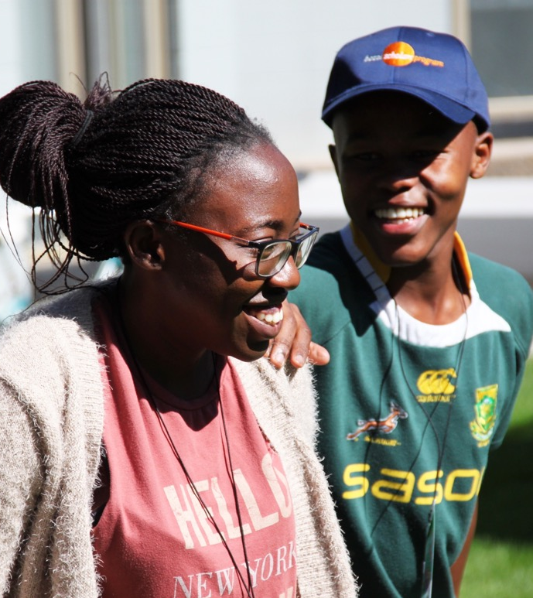








Throughout the program, we aim for students to build their belief and ability in the following leadership skills:
Sense of Belonging
Connection to the program and ability instill it in others.
Leadership Efficacy
Belief in their ability to succeed as a leader.
Agency
Ability to start and sustain goal-directed efforts.
Resilience
Ability to persist through challenges and cope with stress in healthy ways.
Purpose
Explore what gives your life meaning and align it with your choices.
Collaboration
Desire and ability to work effectively with others.
Leadership Outcomes
Civic Impact
Ability to take action to positively impact your community.
Navigating Pathways
Ability to envision multiple ways to achieve a goal.
Notes:
For Educator Scholars, a majority report that the year-long program becomes a memorable and meaningful experience that deepens and/or reignites their passion and commitment to their field. In their role as mentors, advocates, and allies to Student Scholars. Go to https://www.bezosscholars.org/explore/impact/ to see what learning outcomes we aim Educator Scholars to make meaningful gains in that are connected to the student learning outcomes.

Slide 5
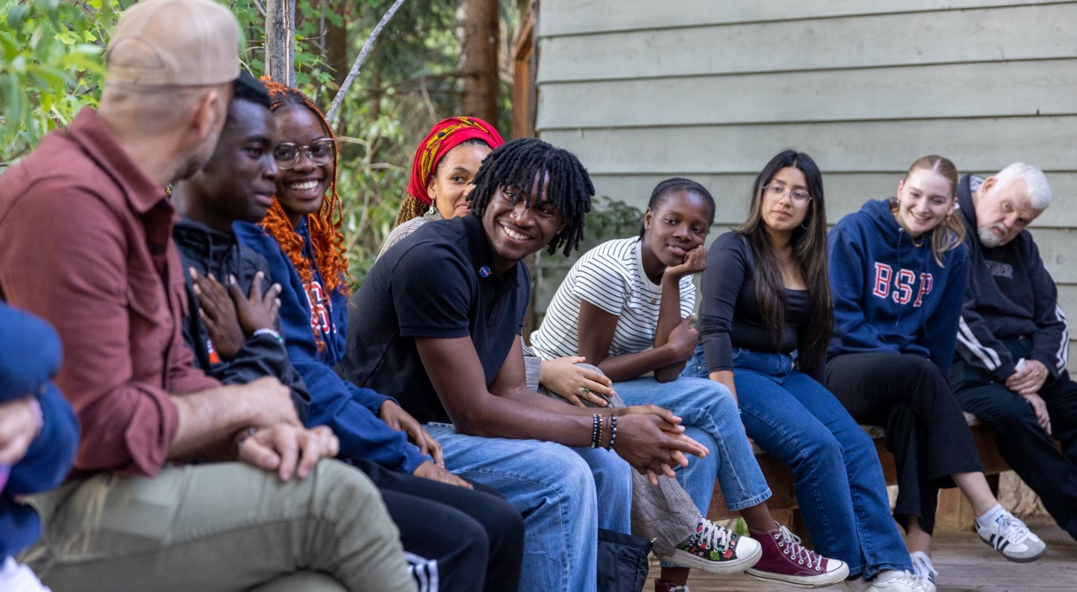
Who are
Bezos Scholars?
Scholars reflect the talent present in every community.
Scholars are:
Passionate and curious
Emerging leaders in their schools and communities
Motivated students
Thrive when collaborating with others
Embrace Challenges
“BSP gave me my first chance to connect beyond my hometown, building comfort with relationships across difference. Through my Scholar Project, I expanded my network, gained new opportunities, and deepened my connection to where I grew up.”
— Sean Ashburn, Student Scholar Alum

Slide 6
Eligibility Criteria
To be eligible to apply, U.S. students must:
Attend an eligible* public high school that meets one or more of the following criteria:
  At least 30% of the school’s students qualify for free or reduced lunch
  The school is designated as a Title I school.
  The state has identified the school as economically underserved; it meets the threshold for a state or district “high need” or meets the equity index used to allocate additional funding.
Be a junior at the time they are applying to the program.
Have a minimum unweighted GPA of 3.0.
Be enrolled in or have taken at least one advanced course: Honors, Advanced Placement (AP), International Baccalaureate (IB), or college-level.
Can fully participate in the year-long program and attend all dates for the trip in Aspen, Colorado, June 24 through the 30, 2026.
Nominate an educator, a supportive adult from their school who fully participates in the yearlong program and goes on the Aspen trip with them.
  * To encourage equity of opportunity, students attending schools who’ve had a Scholar selected in 2024 or 2025 are not eligible to apply. For a full list of current ineligible schools, visit https://bezosscholars.org/apply/eligibility/
Notes:
Potential talking points:
Individual students do not need to qualify for free and reduced lunch to be eligible to apply.
A full list of current ineligible schools is listed on the website at www.bezosscholars.org/faq/#application.

Slide 7
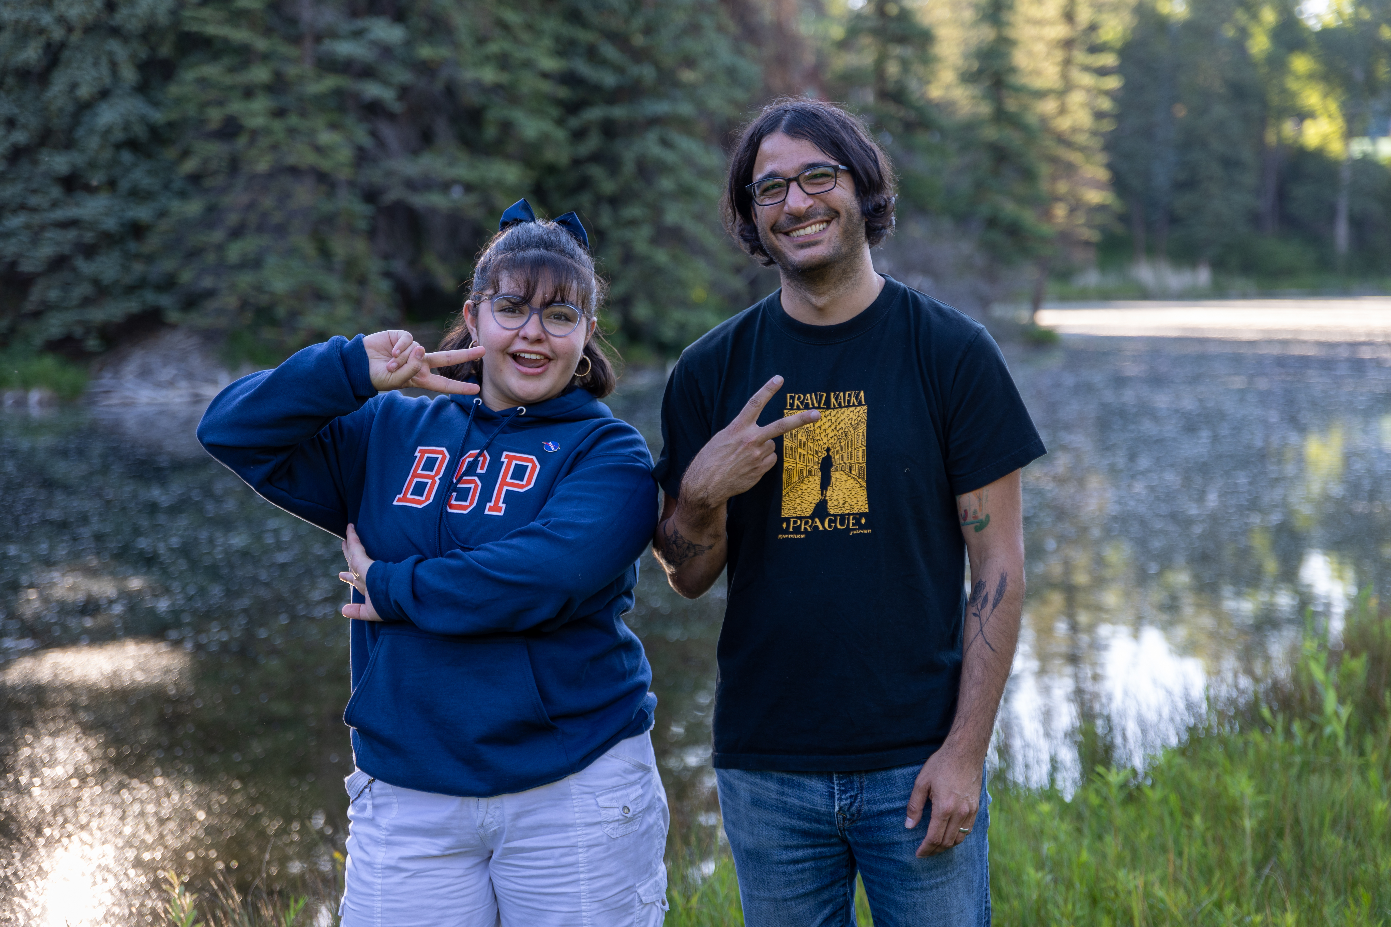
Educator Nominee
Students are required to nominate a trusted adult from their school that will fully participate in the yearlong program alongside them.
Educators travel to Aspen with their student and mentor student leaders as they launch their Community Change Project.
Who is eligible?
A current school staff member, in any position, OR a staff member of a community organization that partners with your school.
Educator nominees CANNOT also be an applicant’s parent, guardian, relative or their paid private tutor or counselor.
What makes a strong nominee?
Strong educator Nominees:
Believe in youth leadership and make space for students to take initiative and lead.
Model learning and reflection, showing openness to new ideas and feedback.
Build strong relationships with students, families, and community partners.
Encourage creativity and problem-solving, supporting students as they design and lead their Community Change Projects.
Stay engaged throughout the yearlong program and while in Aspen, participating fully in virtual workshops, coaching students and helping them with program assignments, milestones and deliverables.
Notes:
Go to www.bezosscholars.org/faq to review commonly asked questions from potential educator nominees and their students.

Slide 8
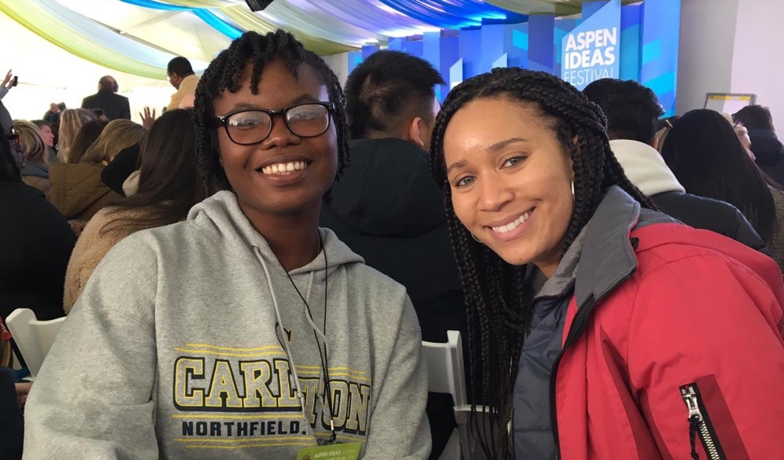
Student & Educator Commitment
From May of the student’s junior year to May of their senior year, Scholars:
Participate in two virtual 2.5-hour Saturday workshops per month along with team meetings and assignments.
Explore and engage with their cohort in Aspen, Colorado, for a full week at the end of June.
Engage community stakeholders to gather insight and input on community needs stemming to inform Community Change Project topic.
Build a diverse and talented team of students and adult supporters, practicing shared leadership to successfully develop and launch a sustainable Community Change Project.
Students and Educator Scholars typically spend about 10 hours per month on program-related activities, including virtual sessions.
During project development and implementation, this may increase to up to 20 hours per month, depending on the needs of their Scholar and their project throughout the year.

Slide 9
How to Apply
Applications are available online at www.bezosscholars.org/apply
Nominate a trusted adult from school to commit to becoming your educator nominee, who completes a recommendation form tied to your application.
Submit a strong completed application by the deadline.
Application Components:
Basic personal contact and demographic information.
General school information, information on classes that challenged you, at least one being an advanced course.
Two extracurricular activities.
A one-minute video on why you want to become a Scholar.
Three short written essay responses.
Educator nominee recommendation form.
Applications are due January 15, 2026!

Slide 10

Founded in 2005, the Bezos Scholars Program is operated and funded by the Bezos Family Foundation a private, independent foundation based in Seattle, WA.
Guided by the belief that all young people deserve the opportunity to reach their full potential and meaningfully contribute to society, the Foundation invests in the science of learning and the experiences that young people from birth through high school need to learn and thrive.
Learn more at www.bezosfamilyfoundation.org
Notes:
In case anyone is curious

